Slide 1

BANK MANAGEMENT SYSTEM
Presented By:
P.Deepika
Batch No:
6258
Enrolled No:
EBEON1121433574

Slide 2
INTRODUCTION
Initially, we can add some (N) customers to the bank and then we can display all account details using:
1) Menu
2) Menu is used to search the bank account
3) Menu is used to deposit money in particular account
4) Menu is used to manager withdrawal
5) Menu is used to exit from the program.

Slide 3
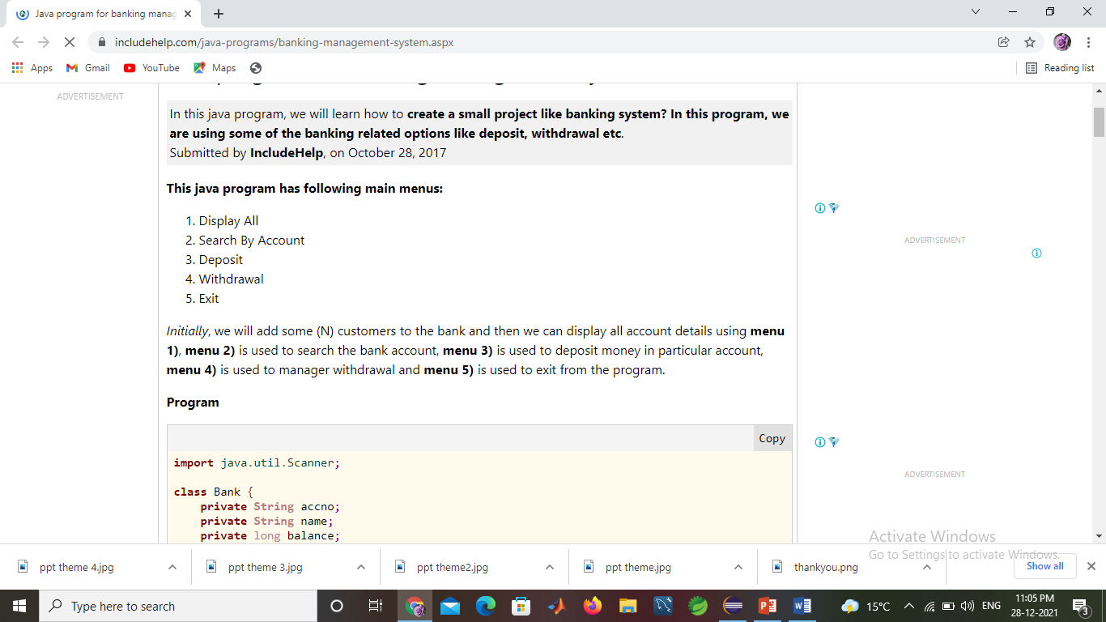
Menu

Slide 4
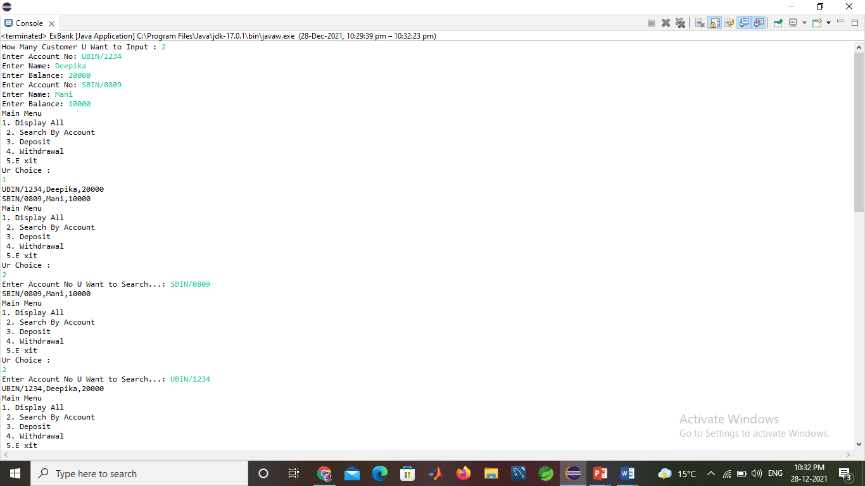
OUTPUT-1

Slide 5
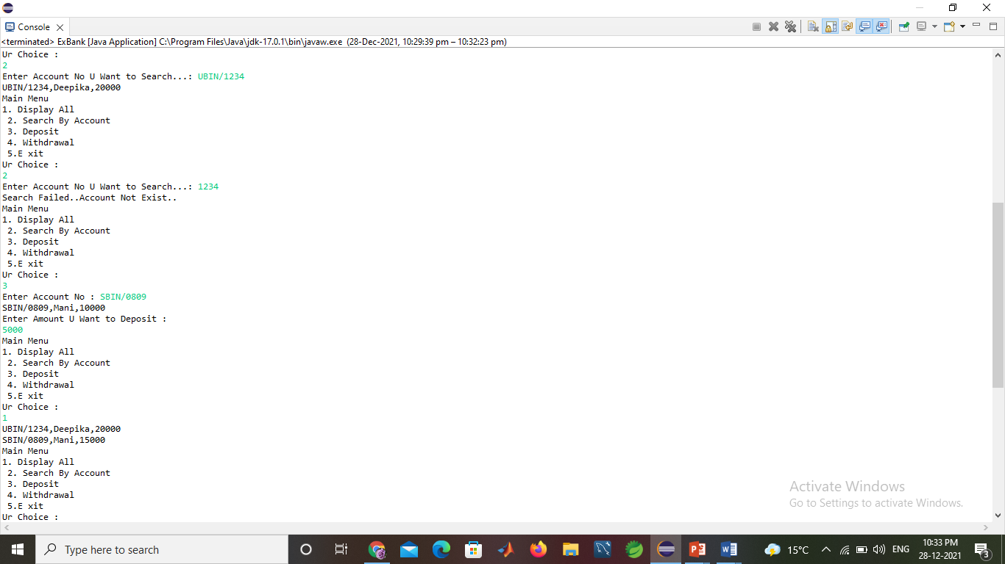
OUTPUT-2

Slide 6
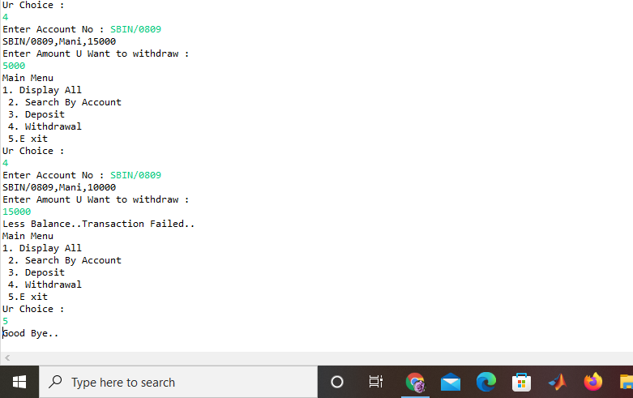
OUTPUT-4

Slide 7


